Slide 1
Spring Internship Program of docu3C : Problem Solving Round
Problem Statement Domain: Machine Learning
Problem Statement:
You have come up with a new idea that uses the employees smartphone and machine learning to provide a contactless system where when an employee enters the firm’s territory, his or her smartphone connects to the server and transmits data from the employee smartphone sensor data like the accelerometer's data. The server performs the calculations and determines this person as one of the employees using Gait analysis.
Essentially it compares the current pattern of the employee’s gait with the historial pattern and if there is a match, the doors automatically open for the employee to walk in.
Design and develop a system that will perform the gait analysis using the given dataset.

Slide 2
Platforms Utilised
Framework: PyCharm version 2023.3.3
Packages imported:
Pandas:
Pandas is an open-source Python library that provides high-level data structures and data manipulation tools designed for data analysis.
Pandas is known for its flexibility, efficiency, and ease of use, making it a popular choice for data manipulation and analysis tasks in Python. It integrates well with other libraries in the Python ecosystem, such as NumPy, Matplotlib, and Scikit-learn.
NumPy:
NumPy, which stands for Numerical Python, is a fundamental package for scientific computing in Python.
It provides support for large, multi-dimensional arrays and matrices, along with a collection of mathematical functions to operate on these arrays efficiently.
NumPy is a foundational library for numerical computing in Python and serves as the backbone for many other libraries in the scientific computing ecosystem
Matplotlib:
Matplotlib is a comprehensive library for creating static, animated, and interactive visualizations in Python.
Matplotlib is a powerful and versatile library for creating high-quality visualizations in Python, making it an essential tool for data scientists, researchers, engineers who needs to communicate insights from data effectively.

Slide 3
Architecture Diagram
The graph is generated
and the data is recorded
in the form of csv file.
The data is loaded
using Pandas package.
Sensor in
smartphone is
activated.
Start
Historical Data
The graph of current gait analysis
is compared with the historical
gait analysis data by the security personal
manually.
Using Matplotlib and
NumPy the graph is
reconstructed.
The data undergoes
preprocessing.
Yes
The gates
will open.
Current Data
No
The gates
will not open.

Slide 4
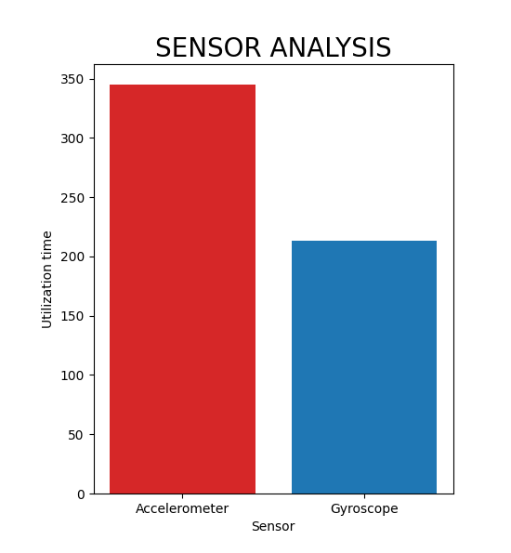
Application Output
The first output is the Sensor analysis which shows the utilzation time of each sensor.
From the graph it can be inferred that Accelerometer is used more than the gyroscope.
The graph is implemneted by using Matplotlib package.

Slide 5
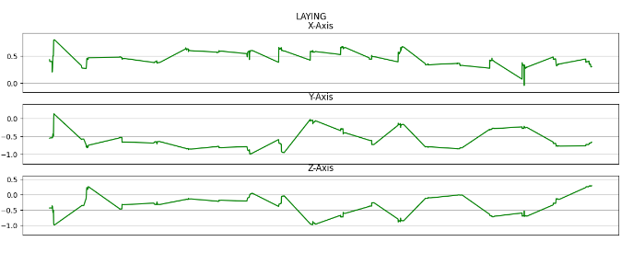
Application Output
The graph of historical gait analysis data of each of the following state has been generated.
Laying
Standing
Sitting
Walking
Walking Upstairs
Walking Downstairs

Slide 6
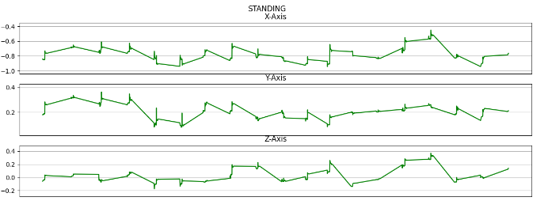
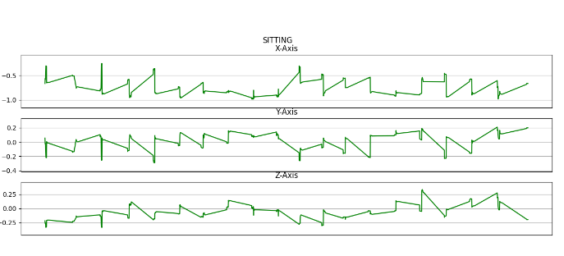
Application Output

Slide 7
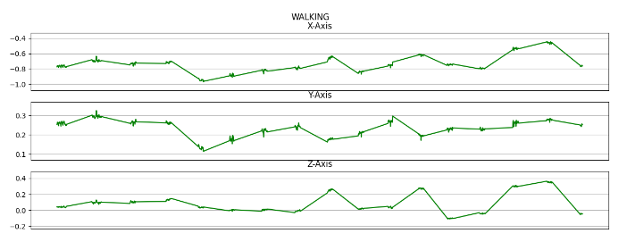
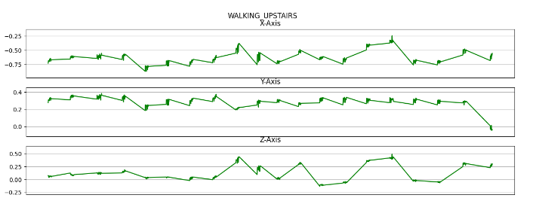
Application Output

Slide 8
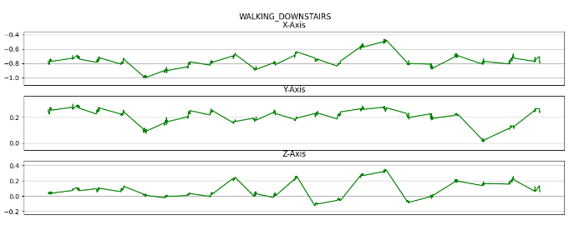
Application Output
Once the graph is generated for all six states, the next step is followed.
The graph of current gait analysis data of each of the following state has been generated.
Laying
Standing
Sitting
Walking
Walking Upstairs
Walking Downstairs

Slide 9
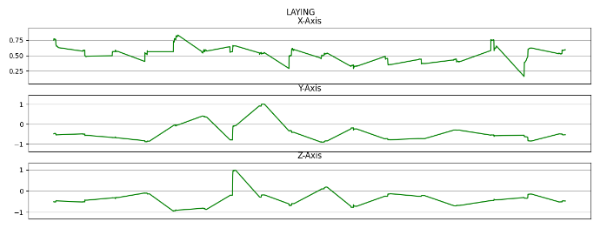
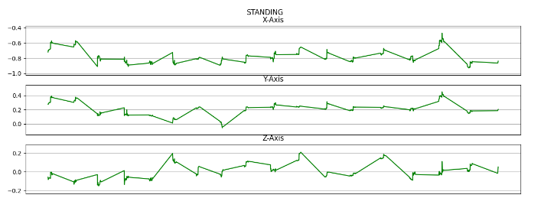
Application Output

Slide 10
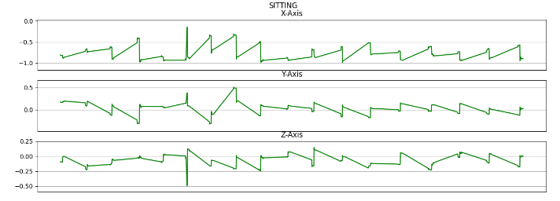
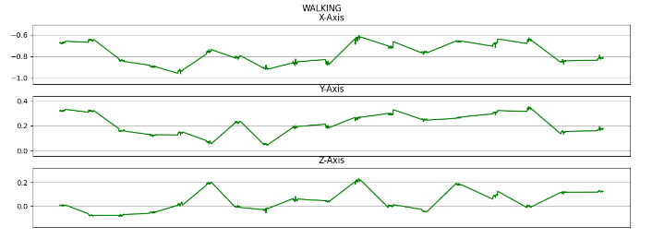
Application Output

Slide 11
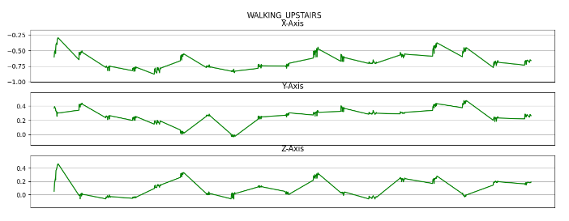
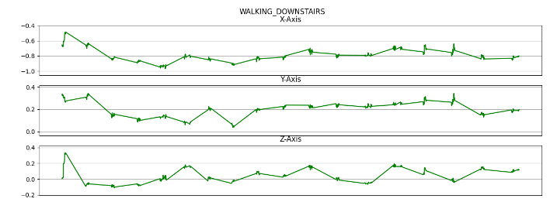
Application Output

Slide 12
Application Output
Historical Gait Analysis Graph
Current Gait Analysis Graph

Slide 13
Application Output
The graph of historical gait analysis and current gait analysis is compared manually for a particular state which is the ‘Walking’ state.
The comparison takes place manually by the security guard of the company.
If the graph is similar, the doors open for the employee. Else the doors do not open.
Use Cases of Gait Analysis
Gait analysis serves as a diagnostic tool in healthcare.
In sports science and athletics, gait analysis can help identify biomechanical factors that contribute to injury risk.
Gait analysis helps in the planning and monitoring of treatments and interventions for individuals with movement impairments.
Gait analysis is also used to optimize athletic performance by assessing and refining movement patterns in sports such as running, cycling, and swimming.
Gait analysis contributes to advancing scientific knowledge in fields such as biomechanics, motor control, and rehabilitation.
Gait analysis provides objective, quantifiable data on various aspects of movement, allowing for more accurate and reliable assessment compared to subjective observations alone.

Slide 14
THANK YOU

